Slide 1
Road Map for IT service management

Slide 2
IT Service management (ITSM)
ISO/IEC 20000-1:2018 is a service management system (SMS) standard. It specifies requirements for the service provider to plan, establish, implement, operate, monitor, review, maintain and improve an SMS. The requirements include the design, transition, delivery and improvement of services to fulfil agreed service requirements.

Slide 3
ISO/IEC 20000-1:2018 CAN BE USED BY
An organization seeking services from service providers and requiring assurance that their service requirements will be fulfilled.
An organization that requires a consistent approach by all its service providers, including those in a supply chain.
A service provider that intends to demonstrate its capability for the design, transition, delivery and improvement of services that fulfil service requirements.
A service provider to monitor, measure and review its service management processes and services.
A service provider to improve the design, transition, delivery and improvement of services through the effective implementation and operation of the SMS.
An assessor or auditor as the criteria for a conformity assessment of a service provider's SMS to the requirements in ISO/IEC 20000-1:2011.

Slide 4
ISO 20000-1
ISO 20000 provides the organization with the means to operate more effectively and efficiently.
ISO 20000 provides an auditable method by which it can assess the quality and conformance of its IT Services.
ISO 20000 assists organizations to enforce process compliance.
ISO 20000 helps to significantly improve the morale of the IT department, the business and ultimately the Customer.
ISO 20000 provides clear evidence that the quality of IT Service Management is taken seriously.

Slide 5
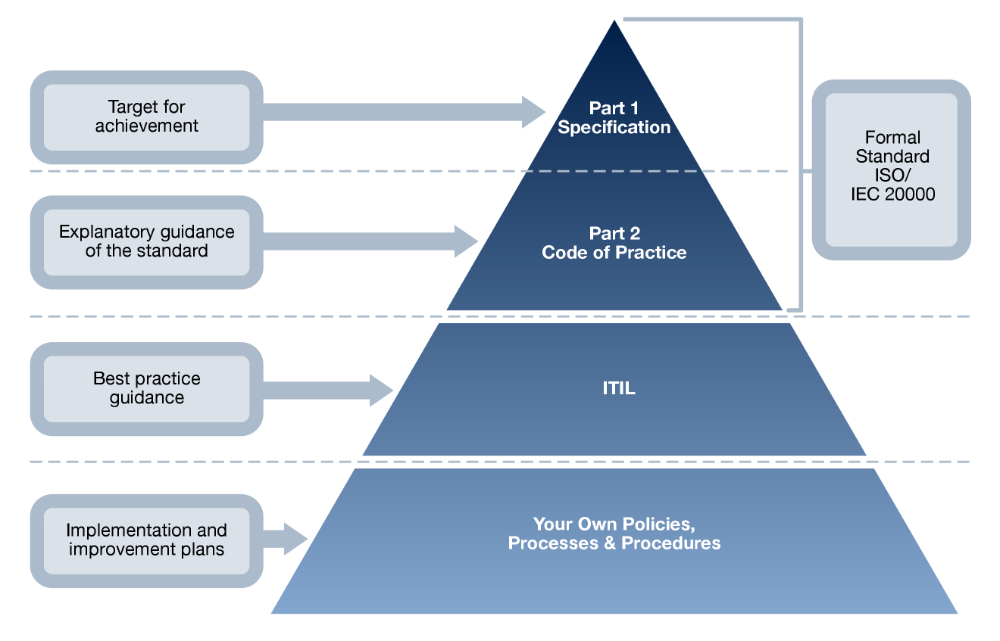
IT Service Management Framework
Or other guidance
With acknowledgement of BSI, OGC and ITSMF
Notes:
We saw this earlier.
We are now going to look at ISO20000 – the standard.

Slide 6
4.3 Define the scope of the SMS
The service provider shall define and include the scope of the SMS in the service management plan.
The scope shall be defined by the name of the organizational unit providing the services, and the services to be delivered.
The service provider shall also take into consideration other factors affecting the services to be delivered including:
a) geographical location(s) from which the service provider delivers the services.
b) the customer and their location(s).
c) technology used to provide the services.

Slide 7
4.4 Service Management System
The service provider shall implement and operate the SMS for the design, transition, delivery and improvement of services according to the service management plan, through activities including at least:
a) allocation and management of funds and budgets.
b) assignment of authorities, responsibilities and process roles.
c) management of human, technical and information resources.
d) identification, assessment and management of risks to the services.
e) management of service management processes.
f) monitoring and reporting on performance of service management activities.

Slide 8
Clause #5.1.1 Management Commitment
Top management shall provide evidence of its commitment to planning, establishing, implementing, operating, monitoring, reviewing, maintaining, and improving the SMS and services by:
a) establishing and communicating the scope, policy and objectives for service management.
b) ensuring that the service management plan is created, implemented and maintained in order to adhere to the policy, achieve the objectives for service management and fulfill the service requirements.
c) communicating the importance of fulfilling service requirements.
d) communicating the importance of fulfilling statutory and regulatory requirements, and contractual obligations.
e) ensuring the provision of resources.

Slide 9
5.3 Organizational Roles and Responsibilities & Authority
Top management shall appoint a member of the service provider's management who, irrespective of other responsibilities, has the authorities and responsibilities that include:
ensuring that activities are performed to identify, document and fulfill service requirements.
assigning authorities and responsibilities for ensuring that service management processes are designed, implemented and improved in accordance with the policy and objectives for service management.
ensuring that service management processes are integrated within the SMS.
ensuring that assets, including licenses, used to deliver services are managed according to statutory and regulatory requirements and contractual obligations.
reporting to top management on the performance and opportunities for improvement to the SMS and the services.

Slide 10
8.2.3 Control of parties involved in the service lifecycle
The service provider shall identify all processes, or parts of processes, for which requirements are specified in Clauses 5 to 10, that are operated by other parties. Other parties can be an internal group, a customer or a supplier. The service provider shall demonstrate governance of processes operated by other parties by:
demonstrating accountability for the processes and authority to require adherence to the processes.
controlling the definition of the processes, and interfaces to other processes, in Clauses 5 to 10.
determining process performance and compliance with process requirements.
controlling the planning and prioritizing of process improvements.

Slide 11
8.2.3 Control of parties involved in the service lifecycle
When a supplier is operating parts of the processes, the service provider shall manage the supplier through the supplier management process.
When an internal group or a customer is operating parts of the processes, the service provider shall manage the internal group or the customer through the service level management process.

Slide 12
6 Planning the SMS (Plan)
The service provider shall create, implement and maintain a service management plan. Planning shall take into consideration the service management policy, service requirements and requirements in this part of ISO/IEC 20000. The service management plan shall contain or include a reference to at least the following:
a) service management objectives that are to be achieved by the service provider.
b) service requirements.
c) known limitations which can impact the SMS.
d) policies, standards, statutory and regulatory requirements, and contractual obligations.
e) framework of authorities, responsibilities and process roles.

Slide 13
6 Planning the SMS (Plan)
f) authorities and responsibilities for plans, service management processes and services.
human, technical, information and financial resources necessary to achieve the service management objectives.
approach to be taken for working with other parties involved in the design and transition of new or changed services process.
approach to be taken for the interfaces between service management processes and their integration within the SMS.
approach to be taken for the management of risks and the criteria for accepting risks.

Slide 14
6 Planning the SMS (Plan)
technology used to support the SMS.
how the effectiveness of the SMS and the services will be measured, audited, reported and improved. Plans created for specific processes shall be aligned with the service management plan.
The service management plan and plans created for specific processes shall be reviewed at planned intervals and, if applicable, updated.

Slide 15
7 Support of the SMS | 7.1 Resources
The service provider shall determine and provide the human, technical, information and financial resources needed to:
a) establish, implement and maintain the SMS and the services, and continually improve their effectiveness.
b) enhance customer satisfaction by delivering services that fulfill service requirements.

Slide 16
7.2 Competence
The service provider's personnel performing work affecting conformity to service requirements shall be competent on the basis of appropriate education, training, skills and experience. The service provider shall:
a) determine the necessary competence for personnel.
b) where applicable, provide training or take other actions to achieve the necessary competence.
c) evaluate the effectiveness of actions taken.
d) ensure that its personnel are aware of how they contribute to the achievement of service management objectives and the fulfillment of service requirements.
e) maintain appropriate records of education, training, skills and experience.

Slide 17
9.1 Monitoring, measurement, analysis and evaluation
The service provider shall use suitable methods for monitoring and measuring the SMS and the services.
These methods shall include internal audits and management reviews.
The objectives of all internal audits and management reviews shall be documented.
The internal audits and management reviews shall demonstrate the ability of the SMS and the services to achieve service
Management objectives and fulfill service requirements.
Nonconformities shall be identified against the requirements in this part of ISO/IEC 20000, the SMS requirements identified by the service provider or the service requirements.
The results of internal audits and management reviews, including nonconformities, concerns and actions identified, shall be recorded.
The results and actions shall be communicated to interested parties.

Slide 18
9.2 Internal Audit
The service provider shall conduct internal audits, at planned intervals, to determine whether the SMS and the services:
a) fulfill the requirements in this part of ISO/IEC 20000.
b) fulfill the service requirements and the SMS requirements identified by the service provider.
c) are effectively implemented and maintained.
There shall be a documented procedure including the authorities and responsibilities for planning and conducting audits, reporting results and maintaining audit records. An audit program shall be planned.
This shall take into consideration the status and importance of the processes and areas to be audited, as well as the results of previous audits.
The audit criteria, scope, frequency and methods shall be documented.

Slide 19
9.2 Internal Audit
The selection of auditors and conduct of audits shall ensure objectivity and impartiality of the audit. Auditors shall not audit their own work.
Nonconformities shall be communicated, prioritized and responsibility allocated for actions.
The management responsible for the area being audited shall ensure that any corrections and corrective actions are taken without undue delay to eliminate nonconformities and their causes.
Follow-up activities shall include the verification of the actions taken and the reporting of results.

Slide 20
9.3 Management Review
Top management shall review the SMS and the services at planned intervals to ensure their continued suitability and effectiveness. This review shall include assessing opportunities for improvement and the need for changes to the SMS, including the policy and objectives for service management. The input to management reviews shall include at least information on:
a) customer feedback.
b) service and process performance and conformity.
c) current and forecast human, technical, information and financial resource levels.
d) current and forecast human and technical capabilities;.
e) risks.
f) results and follow-up actions from audits.
g) results and follow-up actions from previous management reviews.

Slide 21
9.3 Management Review
h) status of preventive and corrective actions.
i) changes that could affect the SMS and the services.
j) opportunities for improvement. Records of management reviews shall be maintained.
The records from the management review shall include at least decisions and actions related to resources, improvement of the effectiveness of the SMS and improvement of the services.

Slide 22
10.2 Continual Improvement
There shall be a policy on continual improvement of the SMS and the services. The policy shall include evaluation criteria for the opportunities for improvement.
There shall be a documented procedure including the authorities and responsibilities for identifying, documenting, evaluating, approving, prioritizing, managing, measuring and reporting of improvements.
Opportunities for improvement, including corrective and preventive actions, shall be documented.
The cause of identified nonconformities shall be corrected. Corrective actions shall be taken to eliminate the cause of identified nonconformities in order to prevent recurrence.
Preventive actions shall be taken in order to eliminate the cause of potential nonconformities in order to prevent occurrence.

Slide 23
10.2 Continual Improvement
Documented opportunities for improvement shall be prioritized. The service provider shall use the evaluation criteria in the policy on continual improvement, when making decisions on opportunities for improvement. Approved improvements shall be planned.
The service provider shall manage improvement activities including at least:
a) setting targets for improvements in one or more of quality, value, capability, cost, productivity, resource utilization and risk reduction.
b) ensuring that approved improvements are implemented.
c) revising the service management policies, plans, processes and procedures, where necessary.
d) measuring implemented improvements against the targets set and where targets are not achieved, taking necessary actions.
e) reporting on implemented improvements.

Slide 24
ISO 20000 Process Model
Customers
(and other
Interested
parties )
Service Management System
Customers
(and other
Interested
parties )
Plan
SMS general requirements
Management responsibility
Governance of processes
operated by other parties
Plan, operate, monitor and improve
Documentation management
service management
Resource management
Design, development and transition
Services
Requirements
of new or changed services
Service delivery processes
Do
Capacity management
Service level management
Information security
Act
Service continuity &
Service reporting
management
availability
Budgeting &
management
Control processes
accounting
for services
Configuration management
Change management
Release and deployment
management
Resolution processes
Relationship processes
Incident management
Business relationship
& request fulfilment
management
Problem management
Supplier management
Check

Slide 25
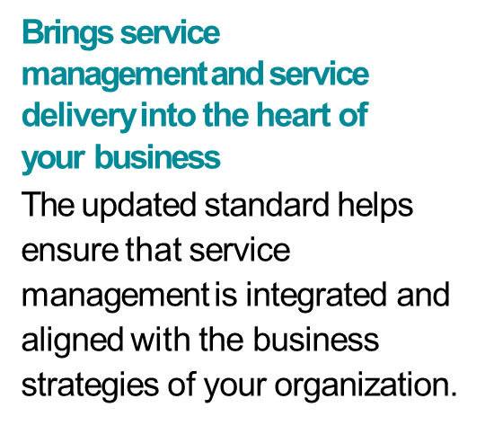
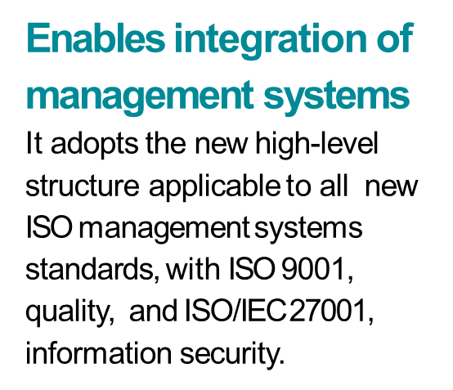
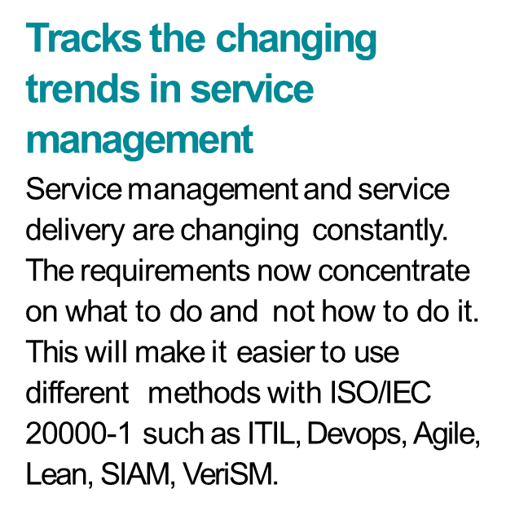
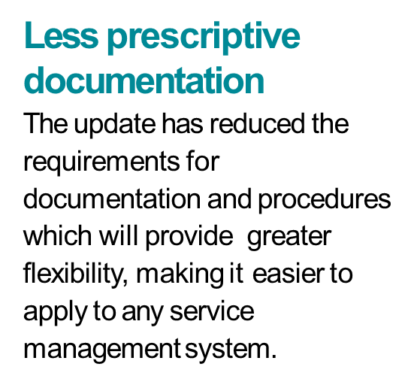
Benefits of ISO 20000-1:2018

Slide 26
The Benefits of ISO20000 Certification
Improved quality of service
Increased business and customer confidence
Improved reputation, consistency and interoperability
Continuous improvement assured
Optimised and controlled costs
Management and staff understand their business, roles and processes better
Demonstrate superiority over competitors
Ability to meet requirements for bids
Easier to justify or combat outsourcing
Enforces move from “should” to “shall”
Impartial and external audit
Certification recognised internationally

Slide 27
Reasons to get certified
Eligibility for submitting tenders or proposals for projects.
Generates new business opportunities.
Can boost your organization's brand reputation and be a useful promotional tool, especially when going up against competitors who aren’t certified.
Supports address organizational risks and opportunities in a structured manner.
Increased customer confidence and satisfaction.

Slide 28
Suggested time lines
End by:
Week 1
Week 2
Week 6
Week 8
Week 9 onwards
Week 13
Gap analysis of the system
Identification of teams and groups
Process definition & Policy
Review of the Processes
Implementation of processes
Implementation review 1

Slide 29
Suggested time lines
End by:
Week 13
Week 15
Week 17
Week 20
Week 22
Internal Audit 1 & Management Review Meeting 1
Observation closing
Internal Audit 2 & Management Review Meeting 2
Stage 1 Audit
Stage 2 Audit

Slide 30
Thank You!!
For any clarifications/support/information
contact: admin@lexq.us

