Slide 1


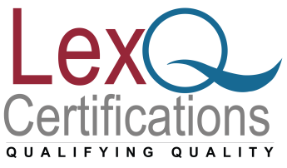

ISO 27001 Internal auditor Training
www.lexnimble.in | www.lexnimble.com
www.lexnimble.in | www.lexnimble.com

Slide 2
ISO 27001 Internal auditor Training
A highly interactive 2 day ISMS ISO 27001:2013 Internal Auditor training course that will teach you the tools and techniques of how to be a internal auditor in your own organization.

Slide 3
Program Outline
Understanding the role of internal audits within the plan-do-check-act cycle of an information security management system and develop an understanding of ISO 27001:2013.
Risk assessment and risk treatment processes within an ISMS and their significance for auditors
How to plan and establish an effective audit programme to ISO 27001:2013

Slide 4
Program Outline
Plan and conduct all phases of an internal audit
Identify non-conformances and writing the same
Learn to analyze root cause, take correction / Corrective actions
Learn to prepare and present Internal Audit results

Slide 5
Learning Objectives
Understand the requirements of ISO 27001:2013
Gain a greater knowledge of the mandatory procedures
Learn where to get information and guidance
Be introduced to the audit process using a risk treatment plan

Slide 6
Who Should Attend?
Quality Managers
Security Managers
Internal Auditors
Quality Co-ordinators
IT Support staff

Slide 7
Any Questions?
Thank You!!
For any clarifications/support/information
contact: admin@lexq.us

