Slide 1
Product Development

Slide 2

About Us
Team
Experienced leadership team and Agile experts
A dedicated team of more than 100 Engineers on cross-functional development
Providing 24 X 7 deployment and support
Infrastructure
A dedicated test lab, testing environment
Complete Mobile technology environment for development and deployment
Partners of VMware & Amazon Web Services
Started in March 2004, we have successfully provided various IT services for clients in US, Canada & India
Currently focusing on expanding to Middle-East, Australia and other Asiatic regions as well.

Slide 3
Our Product Development Model
Discover
(Innovation)
Develop
(Implementation)
PCI/DSS compliance for Secure Web Messaging Application, Tokenizing credit card info
Deliver
(Quality Standards)
Involve QA from the beginning of the project to maintain quality at every stage
Crypto/PKI implementation for Fat client (.NET, WPF) and Mobile apps
Continuous Integration (Build Automation, Test Automation using TFS, Cruise Control etc.)
Extended testing with Security Testing, Load / Performance Testing.
Browser Compatibility Testing of web applications / web services.
Building library components for mobile apps for reuse and quick time-to-market
Apt technology used
Providing innovate approach: Example: Inventory management using iOS Barcode scanning

Slide 4
Our Development Methodology
Agile Model
  Release Management to support task planning, execution and manage backlog
  Focus on shorter iterations and quick deliverables
  Our analysts work with customers to prioritize the features for each iteration
  The outcome of each Iteration is expected to be a working software and will be shared with customer for capturing early feedback
  We use Tools like VersionOne, RallyDev, JIRA, Excel based customized templates for managing requirements, work allocation, tracking, defect tracking etc.
  We capture Agile project matrices e.g. Burn Down, Velocity, First Time Right etc.
  Daily team meetings and weekly management meetings
Iteration Plan | Iteration 0 (Two Weeks) |  | Iteration 1 (Four Weeks) |  |  |  | Iteration 2 (Four Weeks) |  |  |  | Iteration 3 (Four Weeks) |  |  |  | Iteration 4 (Two Weeks)
Solution Architecting
High Level Design
UI Mockup
Product Backlog Preparation
Detailed Design
Implementation (Coding & Unit Testing)
Verification
System / Integration Testing
User Acceptance Testing

Slide 5
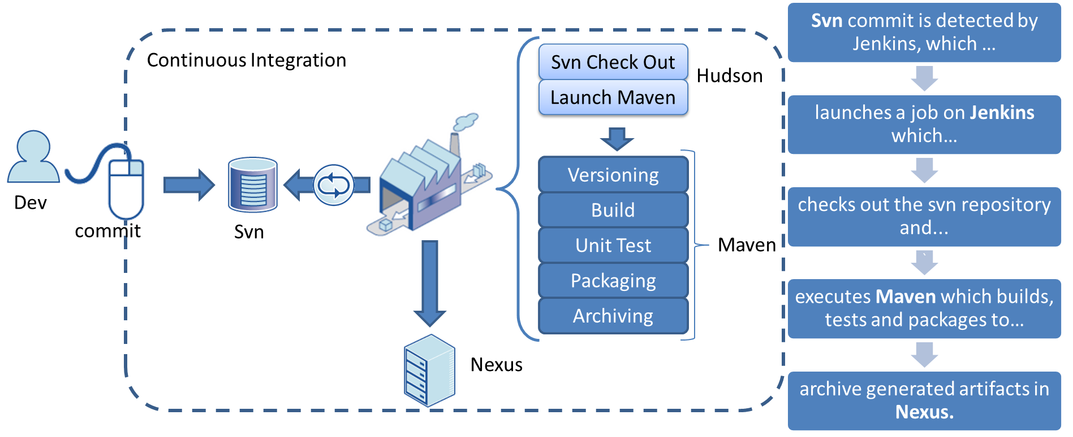
Source Code & Build Management
Source Code Version Management
Use of Sub Version (SVN) for source code management.
Code changes are checked in daily to the SVN project.
The SVN server is hosted with secure public URL and backed up regularly.
Access is extended to onsite team/ customers as needed.
Build Management
  Builds are tagged with unique numbers automated and triggered by Continuous Integration tools
  Code Review, code profiling and coverage analysis is performed
  Code documentation with SandCastle
  Portals and alerts for improved visibility is provided to all stakeholders

Slide 6
Our E-commerce Applications
Case Studies

Slide 7
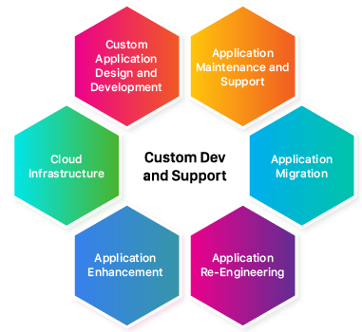
Application Development and Support

Slide 8
As a full-stack web development company, we deliver a wide range of custom web solutions for small and big businesses in different domains. With maximum effort and attention to details, we create web apps, services that accurately answer your expectations and satisfy the specific needs of your company.
The back end and the front end created with the most reliable and relevant modern techs.
Any browser.
Any device.
Flawless user experience.
A thought-out architecture - cloud-native, microservices-based or reactive approach.

Slide 9
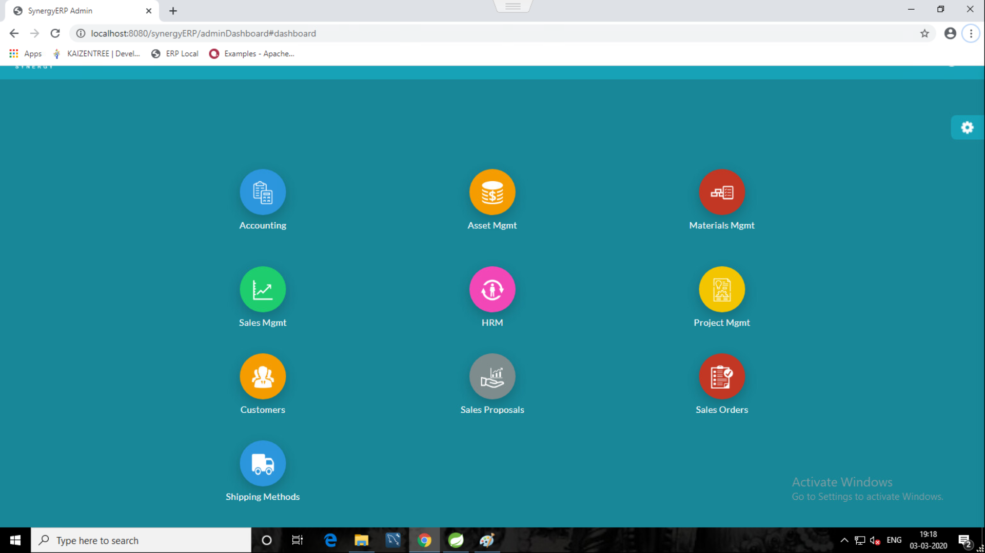
ERP Development
We help organizations by developing customized ERP Solutions
We have professional and highly skilled ERP software developer to provide you with all kinds of solution and services for ERP software.

Slide 10
ERP Development
Lex Nimble created a custom web-based full-featured ERP software for a telecom company with an in-build CRM module and a web portal to embrace all business processes and give them the best control and management.
A fully integrated ERP reporting module for generating reports in one click that allows time-saving for gathering and analyzing the required information and reporting. The system enables the company to manage and analyze relevant data and streamline product development processes from conception to manufacturing.

Slide 11
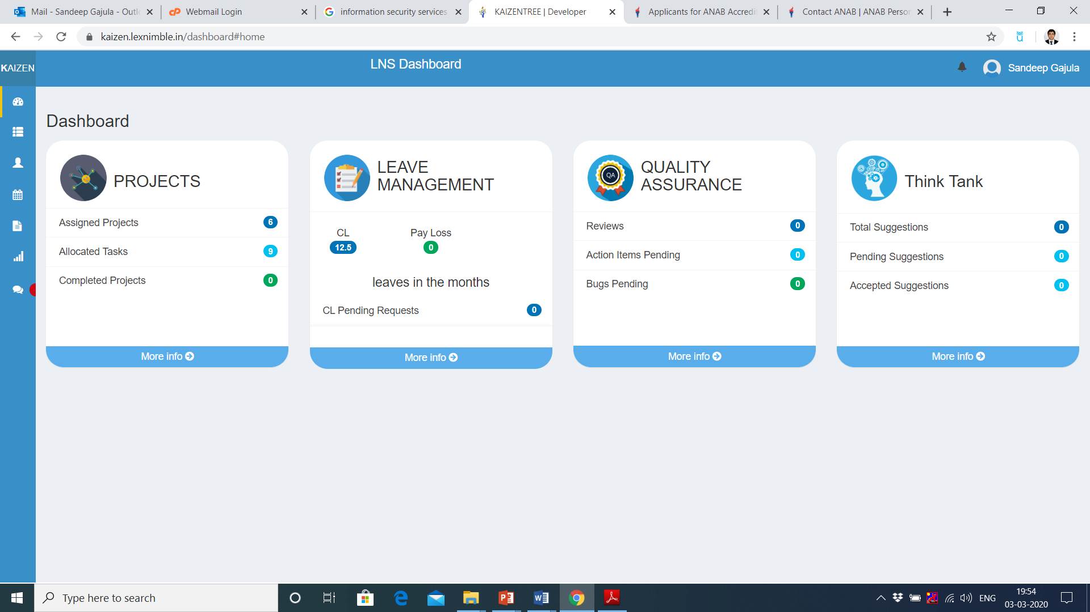
Kaizen Tree

Slide 12
Kaizen Tree
Task Management and Tracking Tool
A task management system for the company with advanced communication features. The application allows users to manage activities by day, week, or month. The management system can be used for evaluating the performance of both individual employees and different departments within the company.
This management app provides a set of tools allowing to monitor the state of the current projects and assign employees to particular tasks.

Slide 13
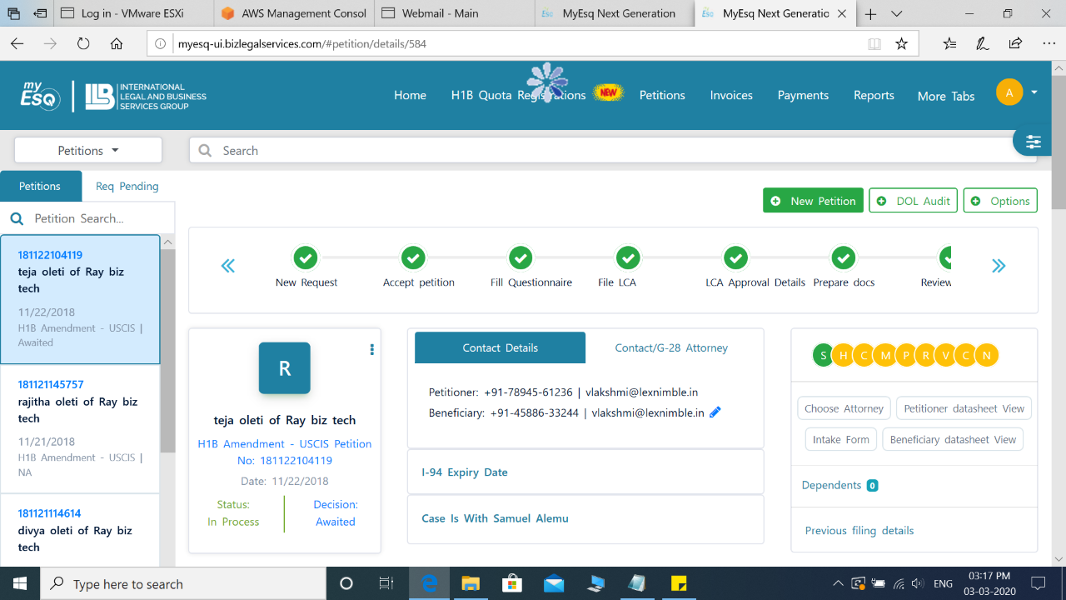
My ESq
MyESQ is an absolutely generic case tracking system that you can use for tracking any sort of Immigration petitions

Slide 14
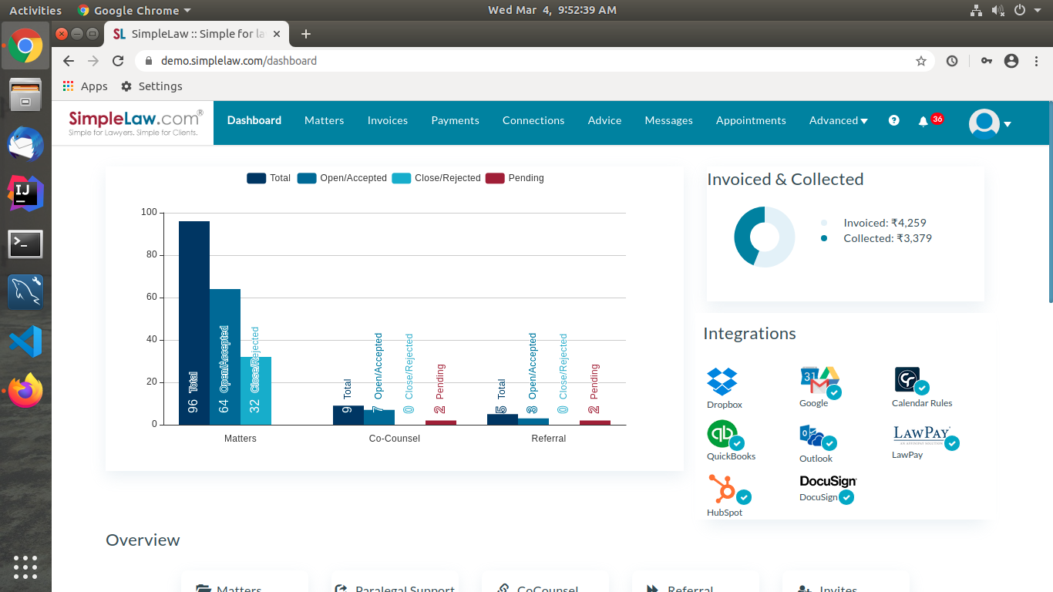
Simple Law
IT is client and attorney platform developed using Java

Slide 15
MULESOFT
MuleSoft helps companies transform their business, enabling them to deliver mobile customer experiences, turn data into digital assets, and dramatically accelerate their pace of innovation and change.
Mulesoft Solutions
Lex Nimble provides creating full stack development for project implementation in open source integrations like JAVA, .NET

Slide 16
Quick Facts of Lex Nimble
Lex Nimble is CMMI Institute Transition Partner, authorized to offer appraisal and training Services
Certified partner of VmEdu for offering Agile Scrum master certification and PMP certifications
We do offer ISO Audits, Systems Consulting and related public and customized Trainings.
More than 315 Satisfied Customers.
Success of 30+ CMMI appraisals by 4 lead appraisers.
Success of 200 + consulting projects covering Quality, Information Security, IT service management.
Rendered 600+ Trainings on Agile Scrum across the globe.
Trained over 20,000+ professionals in India and Internationally on subjects related to PM, ISMS, ITSM, QSM, CMMI, Six Sigma and SPC.

Slide 17
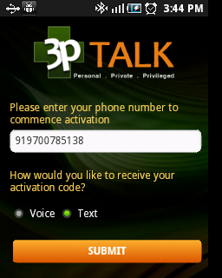
3pTALK – Encrypted Secured Data Healthcare App
Designed for Health Care and Security domain, this impeccable patient-doctor interaction solution facilitates Health Providers to exchange short messages with patients in a very secure and confidential manner.
Message confirmation by signing on touch phone
HIPAA compliant, Single Sign-On with SAML assertions, option to use a standard CA server or our custom built Certification Authority. Also Escrow compliant. OOBA and HOTP implementation.
Multi-tenant architecture and Internationalization support
Read a case-study on the client requirements and our approach on our website.

Slide 18
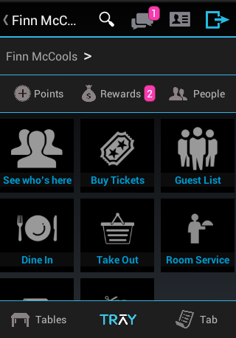
Tray – (eCommerce) Bar & Restaurant App
With integrated Payment Gateway & Chat App
Designed for avoiding queues in a lounge or a bar and to order and pay directly from your smart phone, this bar App is the future of dining experience.
This app allows to log on with email IDs, Face book or G+ credentials. It also allows users to discover what's happening around, find out places with Wi-Fi and connect to them automatically, chat with other users logged on to the same venue etc and much more.
Another Bartender module is for bartenders to receive and process user orders in their bar. It can work with or completely replace the POS systems with a tablet-based system with an online big-data component and built-in marketing, promotions and loyalty features.

Slide 19
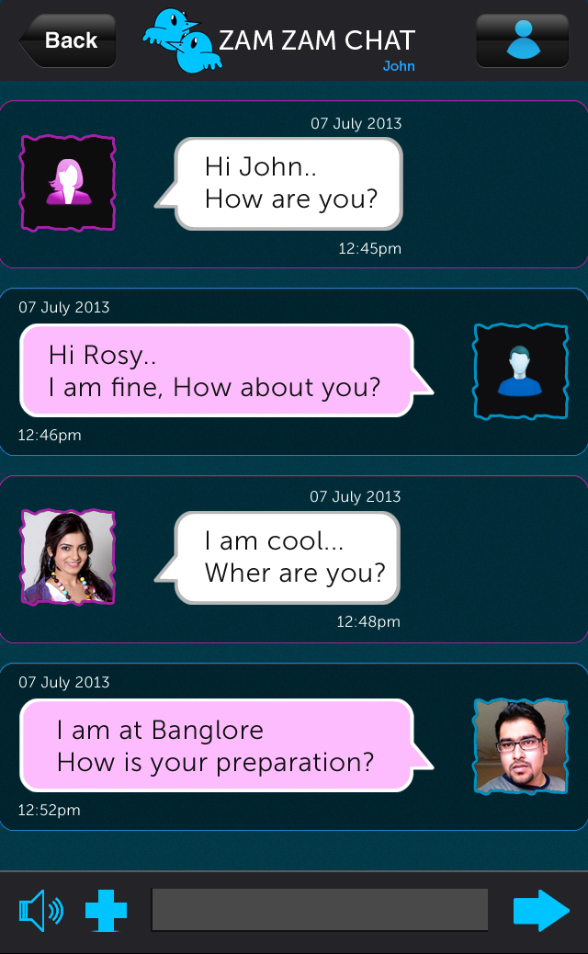
Zam Zam – Peer-to-peer messaging App
  This mobile application allows any mobile user to activate themselves using their phone number.
  This is a product to exchange messages as text, videos, photos within the organizational network like an internal communicator or an IM.
  Developed for both iOS and Android using PKI for Cryptography for mobile apps.
  The web services are developed using GRAIL framework and integrated for authentication using SMS service.
  Peer to Peer communication – XMPP implementation for quick turn-around.

Slide 20
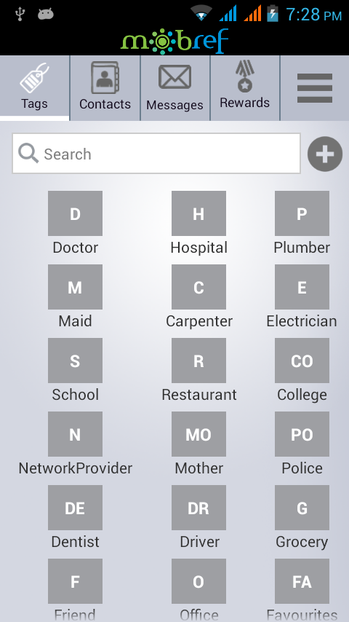
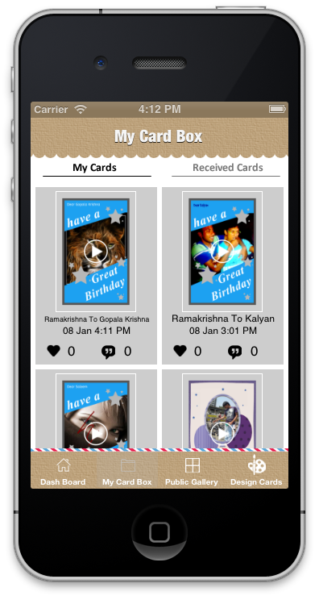
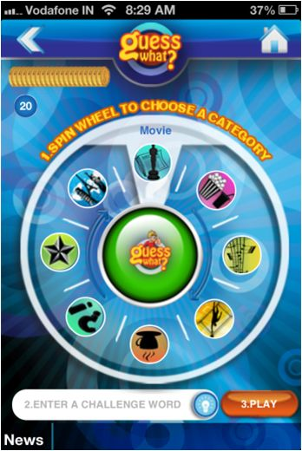
And a few more…
Hola Cards – A new Greeting card experience
A Gaming App
MobRef - for getting easy contacts

Slide 21
Domain Drivers
  Mobile PKI, end to end encryption:
    Asymmetric (public/priv) key generation on mobile clients and encryption
    Symmetric (AES) key generation on mobile clients and encryption
    Generation of CSR
    Validating client certificates before communication
    Local DB encryption (with custom AES and SQLCipher)
  Server Side PKI:
    Built custom Certification Authority for signing CSR
    Single Sign ON – integration with SAML assertions
    Out of Band Authentication (OOBA) through SMS
    OOBA with Custom HOTP implementation (OAUTH)
  Integration with varied payment gateways and services (eg authorize.net, paypal)
  Understanding of OWASP security guidelines
  Experience in PCI/DSS and HIPAA compliance.

Slide 22
Cloud Techology Expertise
  Expertise in building Cloud based applications by using Virtualization services (Amazon EC2, DigitalOcean, RackSpace, Linode)
  Auto-scaling and on-demand scaling using Amazon Services:
    ELB (Elastic Load Balancer)
    EBS (Elastic Block Storage)
    AMIs/VMs management
    Cloudwatch (Continuos monitoring and CDN)
  NoSQL
    Expertise in MongoDB in particular (other products evaluated Neo4J, Cassandra, DynamoDB, RavenDB and CouchBase)
    MongoDB partnership and also certified Java developers and DB developers/administrators.
    Intensive experience in MongoDB tuning.
  RDBMS
    Experience building cross-DB applications and building and maintaining different databases (MSSQL, MySQL, Oracle)

Slide 23
Application Development Expertise
  Extensive experience in building Java based applications using:
    Grails (rapid application development )
    Spring, Hibernate, JPA development
    Experience in writing web socket based applications
  Experience in other server side technology:
    NodeJS (CompoundJS, ExpressJS) and Ruby on Rails
    Php and Python
  Front-end development:
    Responsive design (fits to all device screens) using HTML5 and CSS3
    Jquery, Ajax, AngularJS, BootstrapJS
  Analytics and Visualization tools:
    Tableau, D3.js, Rickshaw
    R, RapidMiner
  Build and Continuous integration
    Maven, Ant
    Hudson and Cruise Control

Slide 24
Contact Us
For your
Product Development needs:
Write to us: chandra@lexnimble.com

