Slide 1


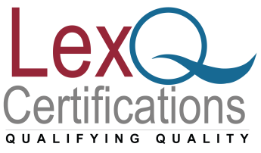

Roadmap for Quality Management System
www.lexnimble.in | www.lexnimble.com
www.lexnimble.in | www.lexnimble.com

Slide 2
ISO 9001 Implementation Process
Depending on the size and scope of your organization, setting up & implementing the Quality Management Standard, ISO 9001 certification process, and ISO 9001 registration can take anywhere from 3 months to 12 months. Listed below are the steps that our ISO 9001 consultants will follow in order to prepare your organization for successful ISO registration:
Core management team training,
Manual preparation – define scope, policy and interaction of business processes,
Defining context of the organization,
Conducting risk assessment,

Slide 3
Draft core processes necessary to show conformance to the standard,
Draft supporting procedures needed to support your processes,
Ensure that all necessary records are identified, created, and implemented,
Conduct a full system Internal Audit, and,
Assist in conducting first Management Review

Slide 4
Common structure for standards
Introduction
Scope
Normative references
Terms and definitions
Context of the organization
Leadership
Planning
Support
Operation
Performance evaluation
Improvement.

Slide 5
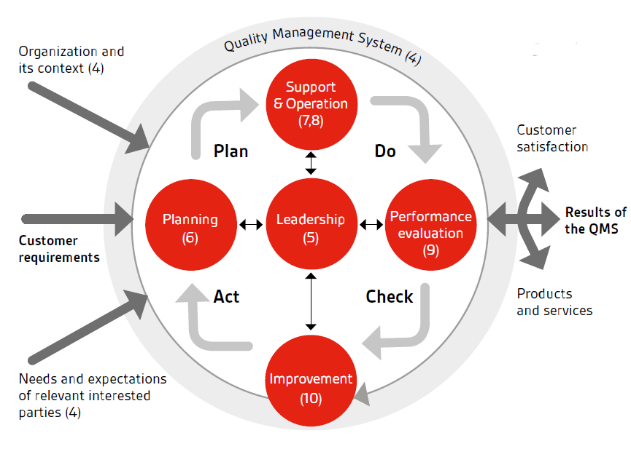

Slide 6
Gain “Top Management” commitment
ISO defines Top Management as "Person or group of people, who directs and controls an organization at the highest level".
Top management must: demonstrate its commitment and determination to implement an ISO 9001 Quality Management System in your organisation. Without top management commitment, no quality initiative can expect to succeed
decide the scope of ISO9001:2015 certification and a target time frame for implementation
decide on your “Quality Policy” and “Quality Objectives"

Slide 7
Perform a gap assessment
The first major task of the MR is to conduct a comparison of your existing QMS with the requirements of the ISO 9001 standard. This is often referred to as " gap assessment'‘ and should determine: what existing company processes and procedures already meet ISO 9001 requirements
what existing procedures and processes need to be modified to meet ISO 9001 requirements
what additional procedures and processes need to be created to meet ISO 9001 requirements

Slide 8
Implementation planning
After the gap assessment, you should have a clear picture of how your existing QMS compares with the ISO 9001 standard.
A detailed implementation plan should then be developed that identifies and describes the tasks required to make your QMS fully compliant with the standard. This plan needs to be both thorough and specific, including the:quality documentation to be developed
person or team responsible
training required
resources required
approvals required (if you are going for third party certification)
estimated completion date

Slide 9
Suggested time lines
End by:
Gap analysis of the system Week 1
Identification of teams and groups Week 2
Process definition & Policy Week 6
Review of the Processes Week 8
Implementation of processes Week 9 onwards
Implementation review 1 Week 13

Slide 10
Suggested time lines
End by:
Internal Audit 1 & Management Review Meeting 1 Week 13
Observation closing Week15
Internal Audit 2 & Management Review Meeting 2 Week 17
Stage 1 Audit Week20
Stage 2 Audit ( Certification Audit) Week 22

Slide 11
Thank You!!
For any clarifications/support/information
contact: admin@lexq.us

