Slide 1


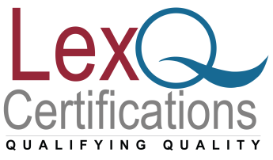

Roadmap for Information Security Management System
Dr.V.Chandrasekhar,
M.Tech, PhD, PMP, SSBB
www.lexnimble.in | www.lexnimble.com
www.lexnimble.in | www.lexnimble.com

Slide 2
Information
Information is an asset that, like other important business assets, is essential to an organization's business and consequently needs to be suitably protected.

Slide 3
Information Security Is:
The application of technology and processes to protect data from
accidental or intentional misuse persons known or unknown
inside or outside of an organization.
By no means strictly a technical aspect, its technical aspects
(firewalls, encryption, access controls, etc.) are important, but so
are processes applied to ever varying situations.
An increasingly high-profile problem as hackers (or crackers) take
advantage of vulnerabilities against parts of an organization’s
network either Internet accessible or internal.

Slide 4
The Need for Information Security
The consequences of insufficient security
  Identity Theft
  Compromised Customer Confidence - Loss of Business
  Service Interruption (e.g. e-mail and application)
  Loss of Competitive Advantage
  Loss of Reputation (e.g. embarrassing media coverage)
  Legal Penalties – fines and other legal action

Slide 5
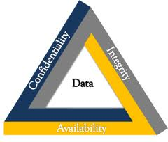
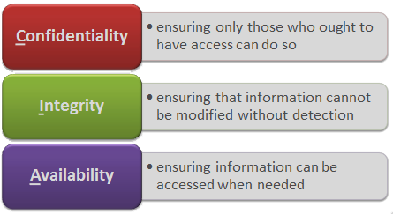
Confidentiality, Integrity and Availability

Slide 6
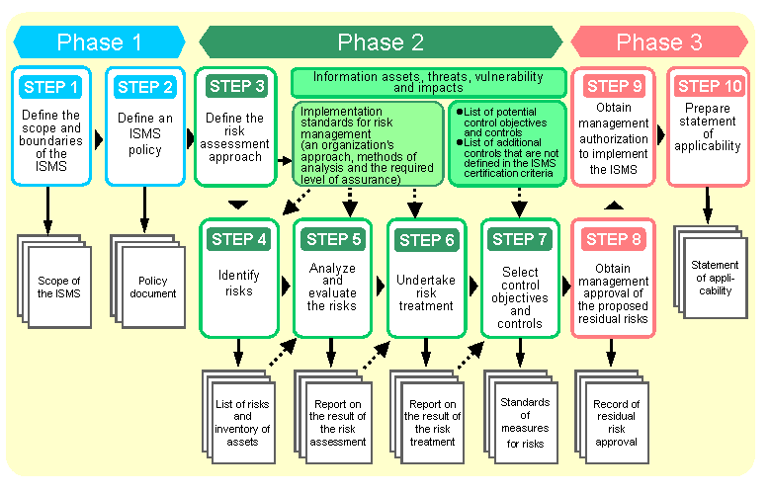
Our ISMS Implementation Methodology

Slide 7
ISO 27001:2013 Requirements
Comprised of the following 10 clauses:
Scope
Normative references
Terms and definitions
Context of the organization
Leadership
6. Planning
7. Support
8. Operation
9. Performance evaluation
10. Improvement

Slide 8
Clause 4 – Context of the organization
4.1 Understanding the org. and its context
4. 2 Understanding the needs and expectations
of interested parties
4.3 Determining the SCOPE
4.4 Information security management system

Slide 9
Clause 5 – Leadership
5.1 Leadership and commitment
5.2 Policy
5.3 Organizational roles, responsibilities and authorities

Slide 10
Clause 6. Planning
6.1 Actions to address risks and opportunities
Risk assessment
Risk treatment
    Risk treatment Options
    Selection of controls from Annex – A
    SOA
6.2 IS objectives and planning to achieving them

Slide 11
Clause 7 – Support
7.1 Resources
7.2 Competence
7.3 Awareness
7.4 Communication
7.5 Documented information
  General
  Creating and Updating
  Control of documented information
Notes:
Notes:

Slide 12
8. Operation
8.1 Operational Planning and control
8.2 IS Risk Assessment
8.3 IS Risk Treatment

Slide 13
9. Performance Evaluation
9.1 Monitoring, measurement, analysis and evaluation
9.2 Internal Audit
9.3 Management Review

Slide 14
10. Improvement
10.1 Nonconformity and corrective action
10.2 Continual Improvement

Slide 15
Annex-A Controls
# | ISO 27001: 2013
A.5 | Information security policies
A.6 | Organization of information security
A.7 | Human resource security
A.8 | Asset management
A.9 | Access control
A.10 | Cryptography
A.11 | Physical and environmental security
A.12 | Operations security
A.13 | Communications security
A.14 | System acquisition, development and maintenance
A.15 | Supplier relationships
A.16 | Information security incident management
A.17 | Information security aspects of business continuity management
A.18 | Compliance

Slide 16
Suggested time lines
End by:
Gap analysis of the system Week 1
Identification of teams and groups Week 2
Process definition & Policy Week 6
Review of the Processes Week 8
Implementation of processes Week 9 onwards
Implementation review 1 Week 13

Slide 17
Suggested time lines
End by:
Internal Audit 1 & Management Review Meeting 1 Week 13
Observation closing Week15
Internal Audit 2 & Management Review Meeting 2 Week 17
Stage 1 Audit Week20
Stage 2 Audit ( Certification Audit) Week 22

Slide 18
Any Questions?
Thank You!!
For any clarifications/support/information
contact: admin@lexq.us

